Slide 1
BASIC MANUAL ROBOTICS

Slide 2
CONTENTS

Slide 3
Components Required
Assembling the Components into a Bot
Locomotion (Controlling the Bot)
Sample Arenas

Slide 4
COMPONENTS
REQUIRED

Slide 5
DC Geared Motors
Wheels
Chassis
DPDT Switches
Remote Box & Ribbon Cables
Power Source (12-24 volt)
Miscellaneous Tools

Slide 6
DC Geared Motors
To choose a proper DC geared motor for making the most appropiate bot, the following factors must be taken into account:
1> Speed ( Angular Velocity in R.P.M. )
2> Torque ( The turning or twisting force )
3> Power ( A combination of the speed & Torque )

Slide 7
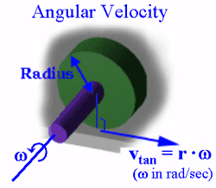
Speed (Angular Velocity)
Motors are devices that convert electrical energy into mechanical energy. The D.C. motors convert electrical energy into rotational energy.
That rotational energy is then used to lift things, propel things, turn things, etc... When we supply the specified voltage to a motor, it rotates the output shaft at some speed. This rotational speed or angular velocity, (w) is typically measured in radians/second {rad/s}, revolutions/second {rps}, or revolutions/minute {rpm}.

Slide 8
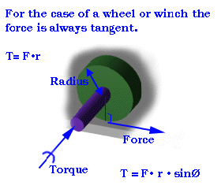
Torque
Torque (also called a moment) is the term we use when we talk about forces that act in a rotational manner. You apply a torque or moment when you turn a dial, drill a hole or tighten a screw or bolt.
In short, Torque is a turning or twisting force that produces or tends to produce rotation or torsion . It is also a measure of the effectiveness of such a force that consists of the product of the force and the perpendicular distance from the line of action of the force to the axis of rotation

Slide 9
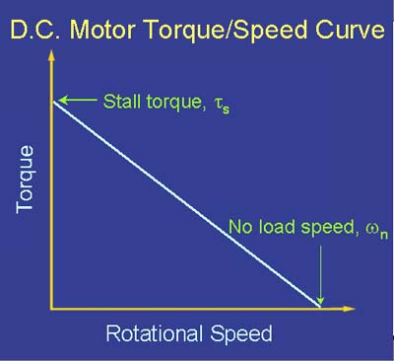
Relation
Between
Angular Velocity
And
Torque

Slide 10
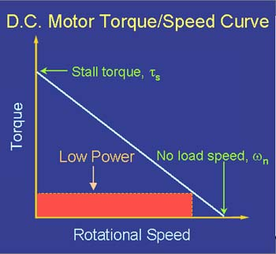
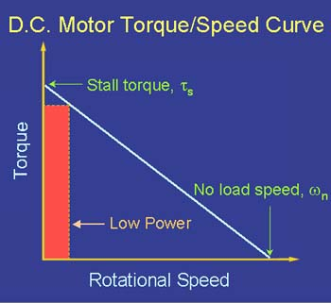
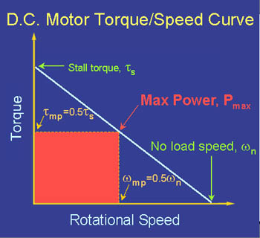
Power
When a torque T (with respect to the axis of rotation) acts on a body that rotates with angular velocity W, its power (rate of doing work) is the product of the torque and angular velocity. This is the analog of the relation P = F·v for particle motion.

Slide 11
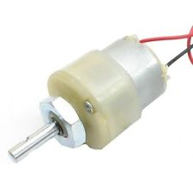
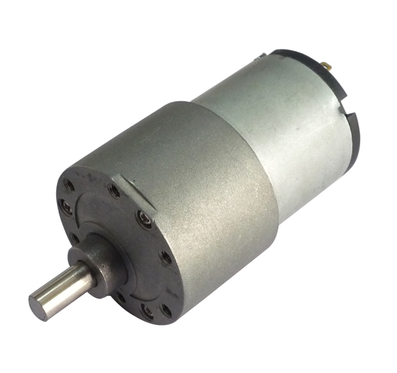
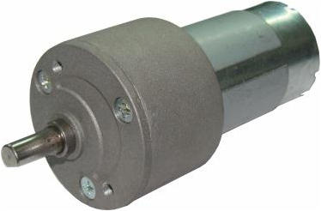
Varieties of DC geared Motors
In Kolkata, There are 3 market available varieties of DC geared motors. They are:
Simple DC motors
Standard Torque: 0.35 Kg-cm
Price: Low
(2) High Torque DC motors
Standard Torque: 2 Kg-cm
Price: High
(3) Johnson Geared DC motors
Standard Torque: 8-20 Kg-cm
Price: Highest

Slide 12
RPM Ranges of DC motors
For Locomotion Purpose, generally motors, ranging from 100 rpm to 800 rpm can be used. But keeping in mind the Speed –Torque relation & the Maximum power output, it will be Better if the rpm range from 300 to 500 is used.

Slide 13
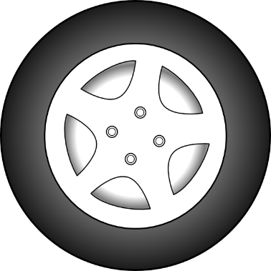
Changing the Direction of Rotation
of a DC Motor
-
-
+
+
The direction of rotation of a DC motor can be easily reversed by simply changing the polarity of the DC power source. This Mechanism is used reversing the direction Motors, as well as in the locomotion of the bot as a whole.
-
+
-
+
+ 12V -
+ 12V -

Slide 14
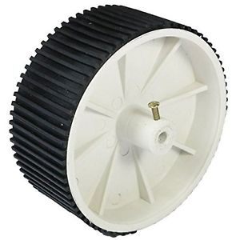
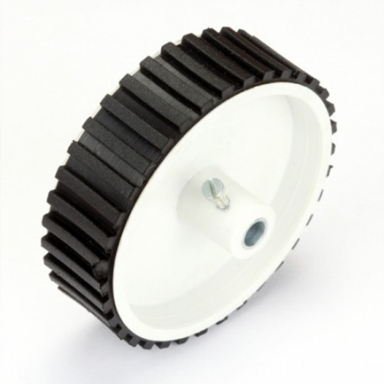
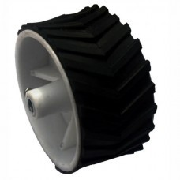
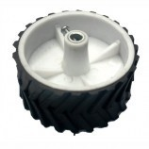
Wheels
There are different kinds of wheels available in the market, with various widths, diameters and grip patterns. Keeping these things in mind, and depending on the utility of the bot, wheels should be chosen carefully.

Slide 15
Let us take an example:
3 wheels are given with 3 different diameters D1, D2 and D3, but with same width. From the figure, it is clear that D1<D2<D3.
Diameter
D3
1>
2>
3>
Diameter
D2
Diameter D1
For each rotation of the motors, the distance covered by the bot will be equal to the circumference of the wheel. So higher the Circumference of the wheel, higher will be the distance covered for each rotations of the motors.
In the given case, keeping other factors normal, choosing the wheel no.3 will be most profitable, as wheel no.3 has the longest diameter or circumference.

Slide 16
Let us take another example:
3 wheels are given with 3 different widths W1, W2 and W3, But with same diameter. From the figure, it is clear that W1<W2<W3.
1>
2>
3>
Width
W3
W1
Width
W2
Higher the width of the wheels, higher will be the area of contact of the bot with the ground. This will give the bot an edge for traversing over uneven soft ground, specially in areas, covered with sand. This will also help the bot to prevent slipping while the bot is climbing along an edge.
So here, choosing the 3rd wheel will be a good choice.

Slide 17
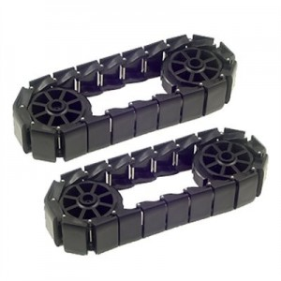
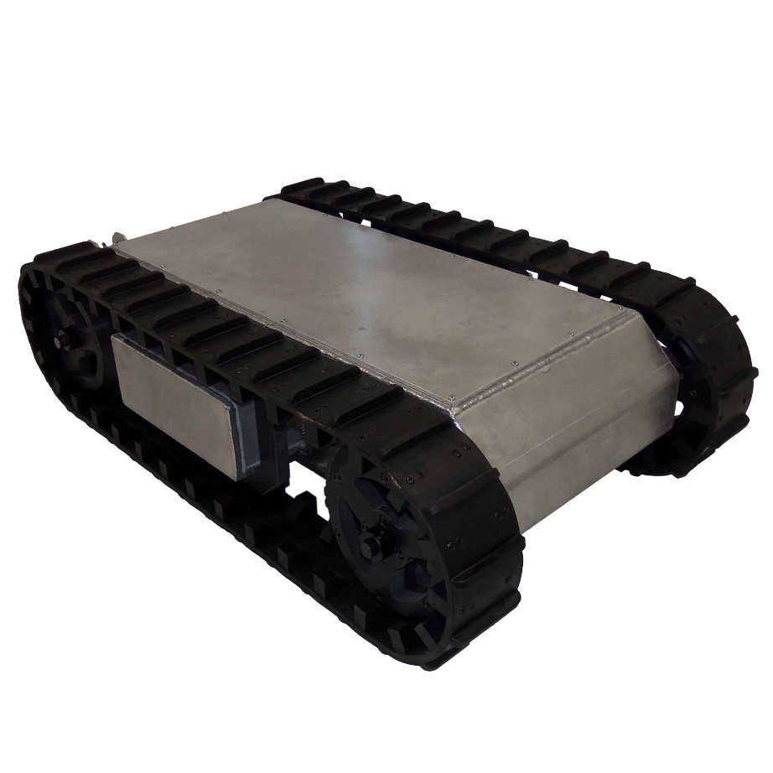
Caterpillar Wheels
Caterpillar track, also called tank thread or Continuous track, is a system of vehicle propulsion in which a continuous band of treads or track plates is driven by two or more wheels.
The large surface area of the tracks distributes the weight of the vehicle better than steel or rubber tyres on an equivalent vehicle, enabling a continuous tracked vehicle to traverse soft ground with less likelihood of becoming stuck due to sinking.

Slide 18
Chassis
A chassis consists of an internal framework that supports a manmade object in its construction and use. It is analogous to an animal's skeleton. An example of a chassis is the underpart of a motor vehicle, consisting of the frame (on which the body is mounted).
Incase of robotics, the base, on which all the components (mainly Motors) are assembled together is called the chassis. One can buy ready-made chassis or else, can make on their own from different materials like wood, ply wood, plastic, metals etc. Some popular types of chassis are:
1> Metallic Chassis
2> Plastic Chassis
3> Wooden Chassis

Slide 19
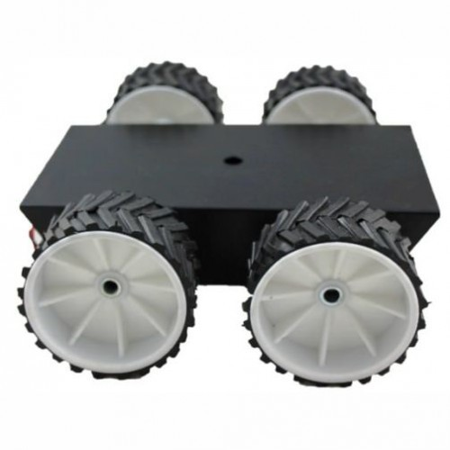
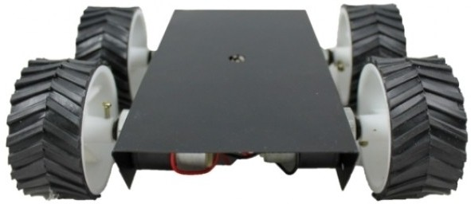
An
Assembled
Bot

Slide 20
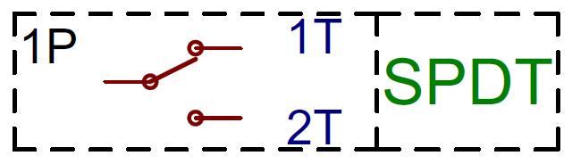
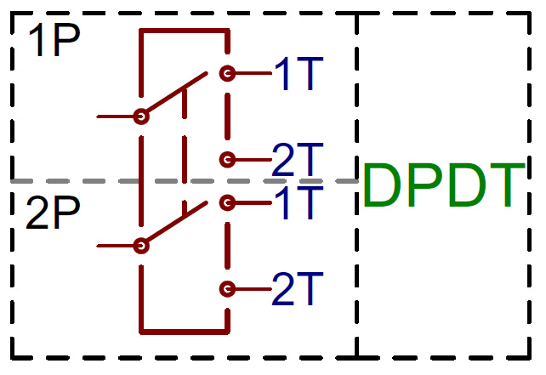
DPDT Switches
A DPDT switch means a Double Pole Double Toggle switch. Basically, it is a combination of 2 SPDT switch.
Adding another pole to the SPDT creates a double-pole, double-throw (DPDT) switch. Here two SPDT switches, which can control two separate circuits, but are always switched together by a single actuator. DPDTs should have six terminals.

Slide 21
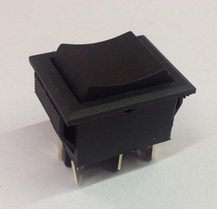
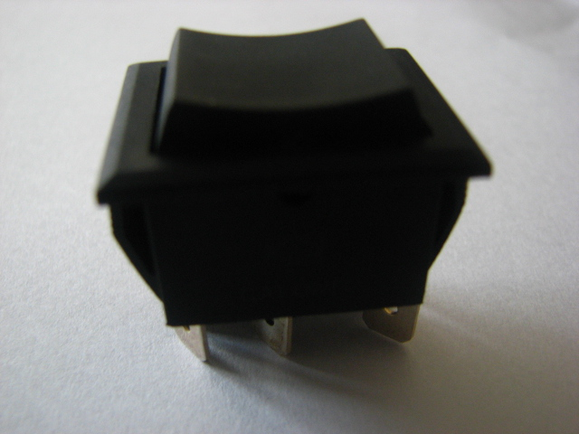
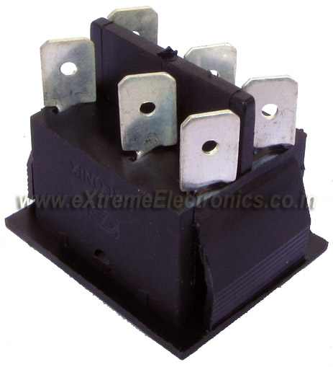
DPDT Switches

Slide 22
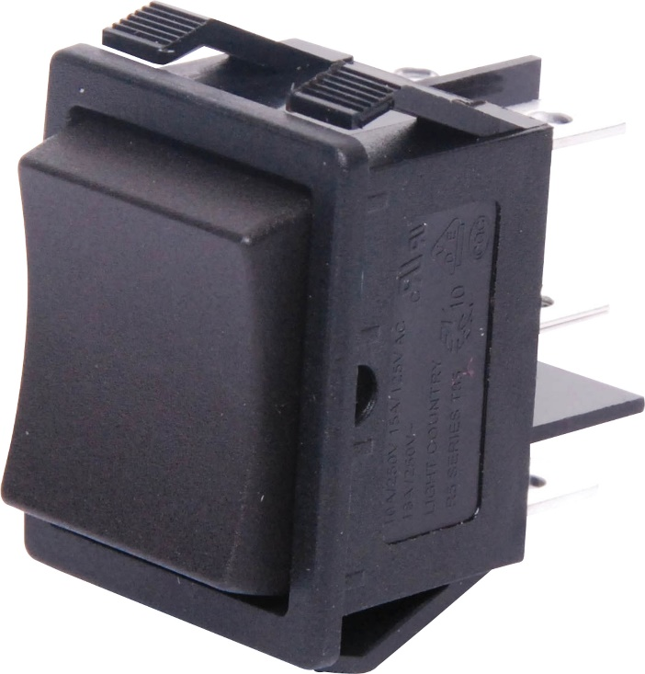
DPDT Switches

Slide 23
DPDT Switches

Slide 24

Connecting a DPDT Switch
With a DC Motor
-
+12 volt DC
Power Supply
+
-
+

Slide 25
Connecting a DPDT Switch
With a DC Motor
-
+
-
+
-
+12 volt DC
Power Supply
+
-
+

Slide 26
Connecting a DPDT Switch
With a DC Motor
-
+
-
+
-
+12 volt DC
Power Supply
+
-
+

Slide 27
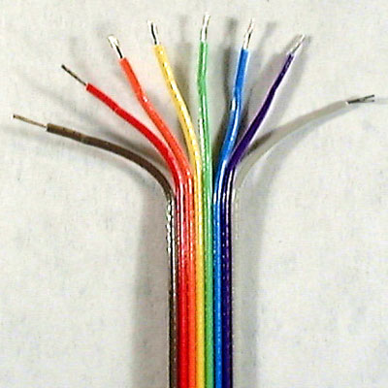
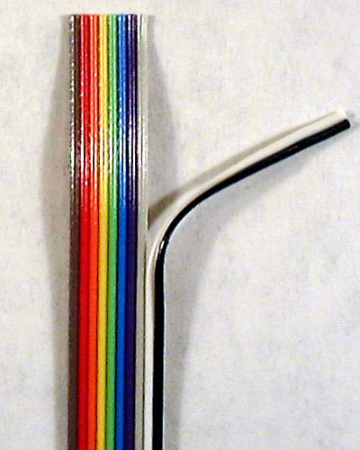
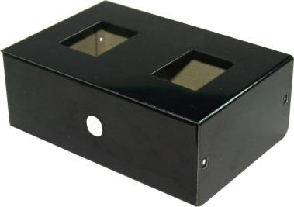
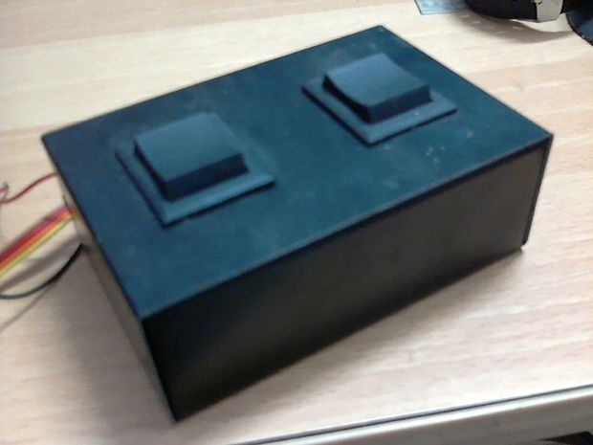
Remote Box & Ribbon Cables
A Remote Box is a plastic box, which is used to hold the DPDT switches in their proper position.
Ribbon Cables (also called Rainbow wires) are generally used for connecting the power source and motors with DPDT switches. The are mostly preferred because they are multi channeled and easy to use.

Slide 28

Power Source
Generally, in a robotics competition, the voltage range from 0 volt to 24 volt is allowed. But it is better to stick around 12-18volt DC power supply. Various types DC voltage sources can be used. But out of them, the most popular one are stated below:
Battery (12-24volt)
12 Volt fixed DC adapter
12 Volt to 24 Volt Variable Voltage DC adapter
SMPS (Switched Mode Power Supply)

Slide 29
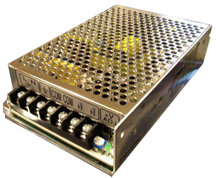
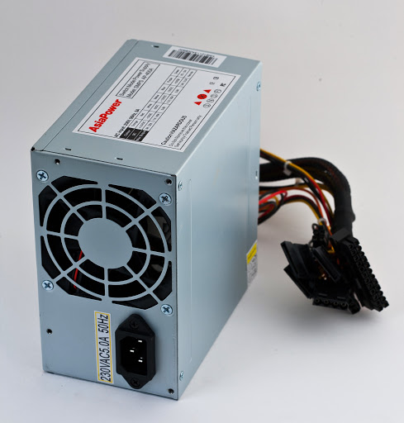
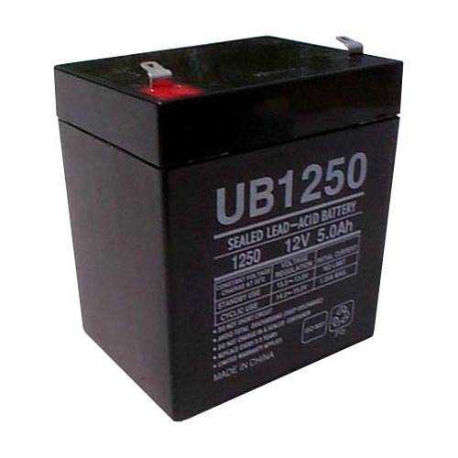
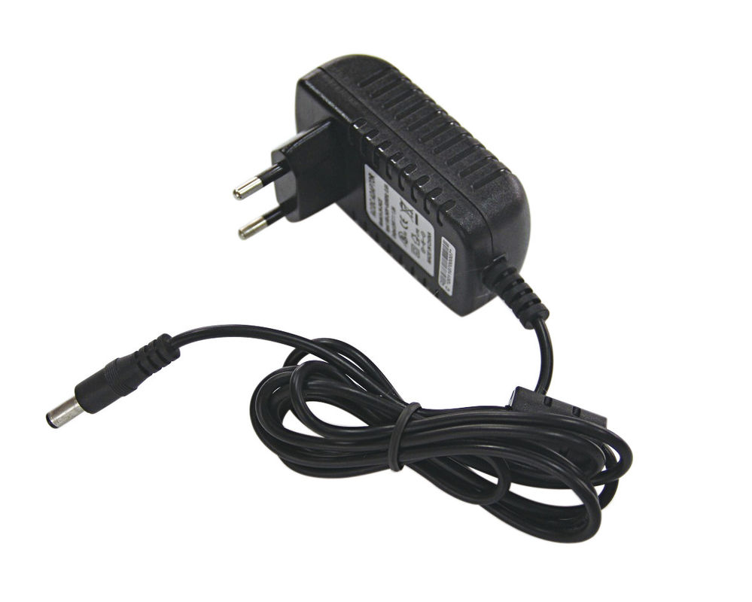
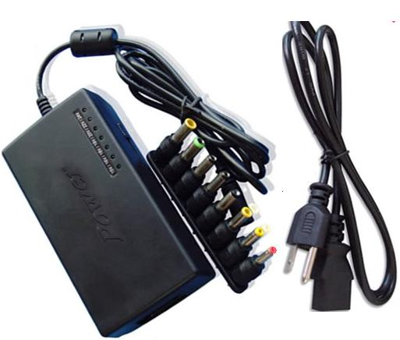
Battery (12-24V)
12V fixed DC Adapter
12-24V Variable DC adapter
SMPS (Switched Mode Power Supply)

Slide 30

Miscellaneous Tools
Apart from the earlier mentioned ones, the various other tools, which will be required are given below:
Screws or nut-bolts
Clamps for holding the motors
Single stranded wires
Wire cutter
Tester or screw driver
Soldering Equipment
Drilling Equipment etc.

Slide 31
Assembling the Components
into a Bot

Slide 32


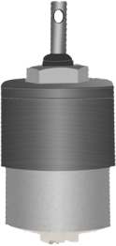

STEP 1: Making the body of the Bot
CHASSIS

Slide 33
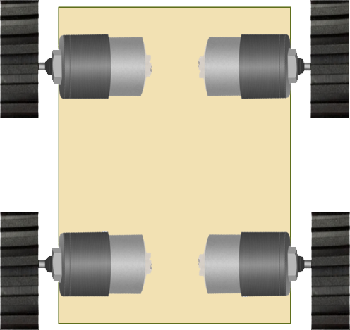
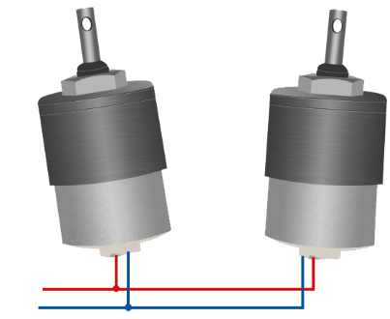
STEP 2: Proper wiring of the Bot

Slide 34
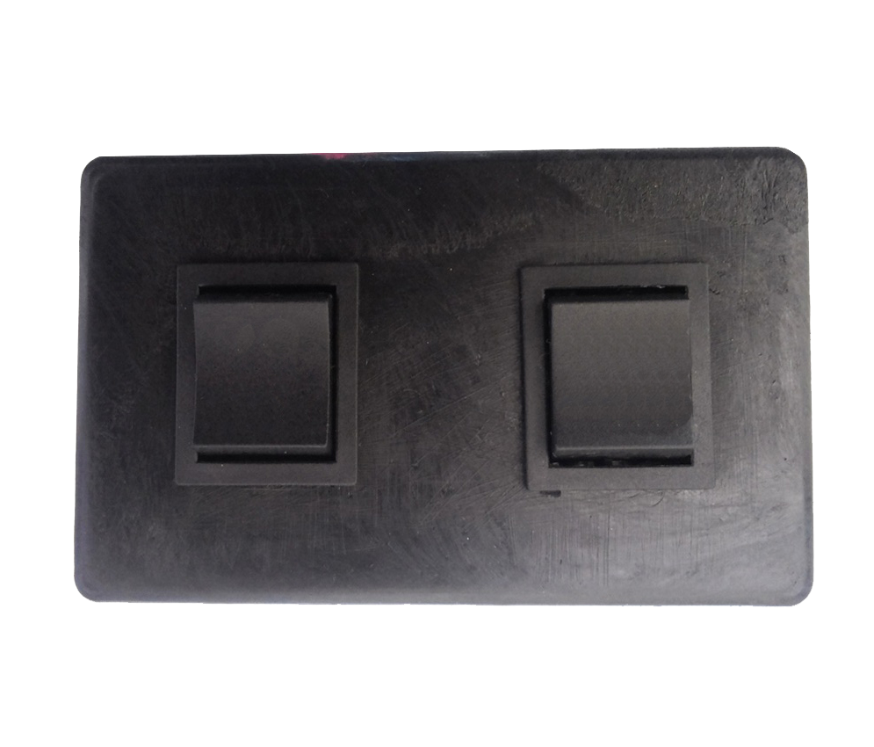
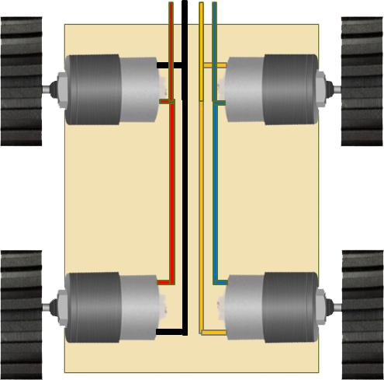

STEP 3: Wiring the DPDT Circuit

Slide 35
STEP 3: Wiring the DPDT Circuit
To the Bot
To the Power Supply

Slide 36
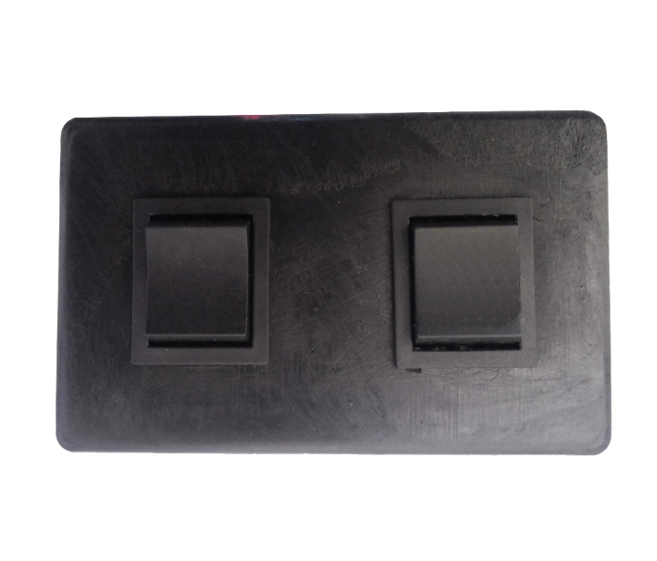
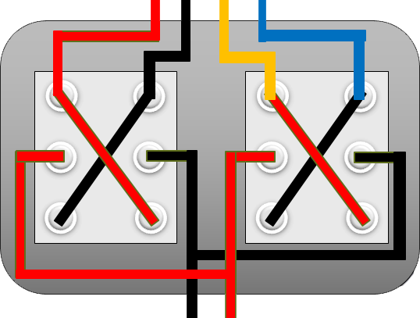
STEP 4: Joining all the Components
- +
POWER SUPPLY

Slide 37
Locomotion
(Controlling the Bot)

Slide 38
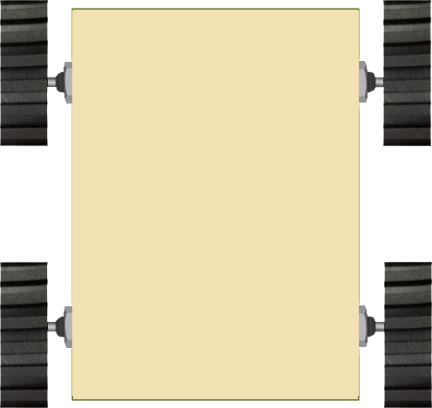

Slide 44


Slide 51
A Sample Arena

Slide 52
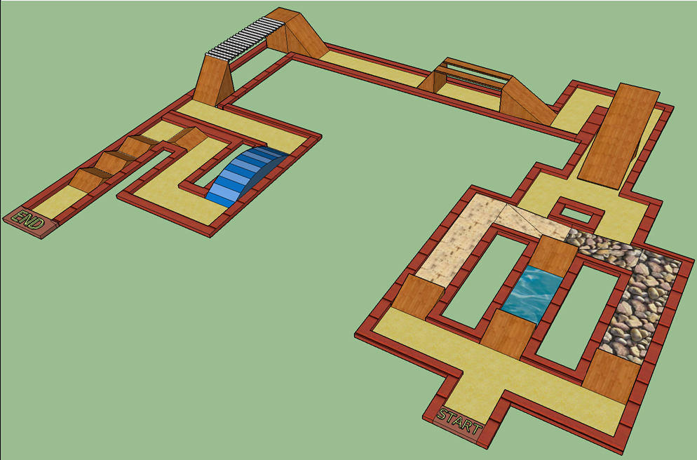
ARENA
Competition : All Terrain Manual Robotics.
Held at : PHOENIX 2015
Reliefs : Normal, Stony areas, Sand Dunes and Water ways.
Maximum Rising Inclination: 45 degrees.
Maximum Falling Inclination: 60 degrees.
Goal : To reach the Finish line as early as possible & avoiding collision with boundary walls to evade negative markings.

Slide 53
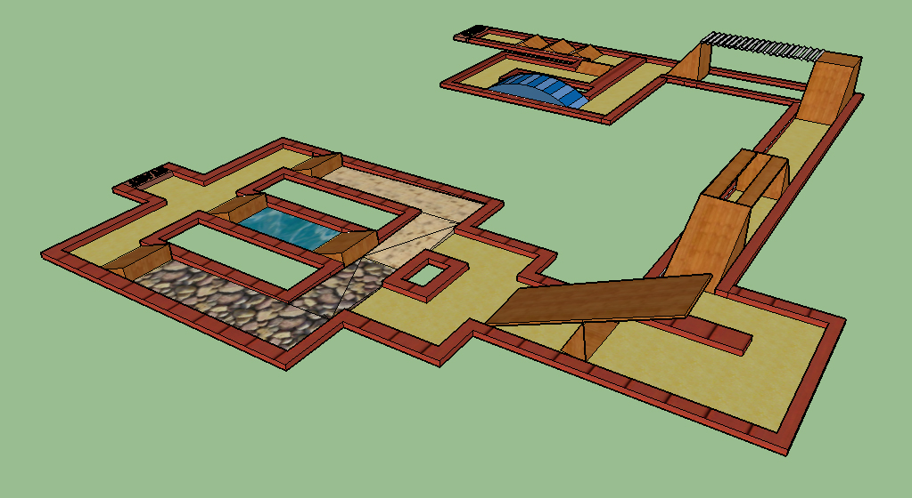

Slide 54
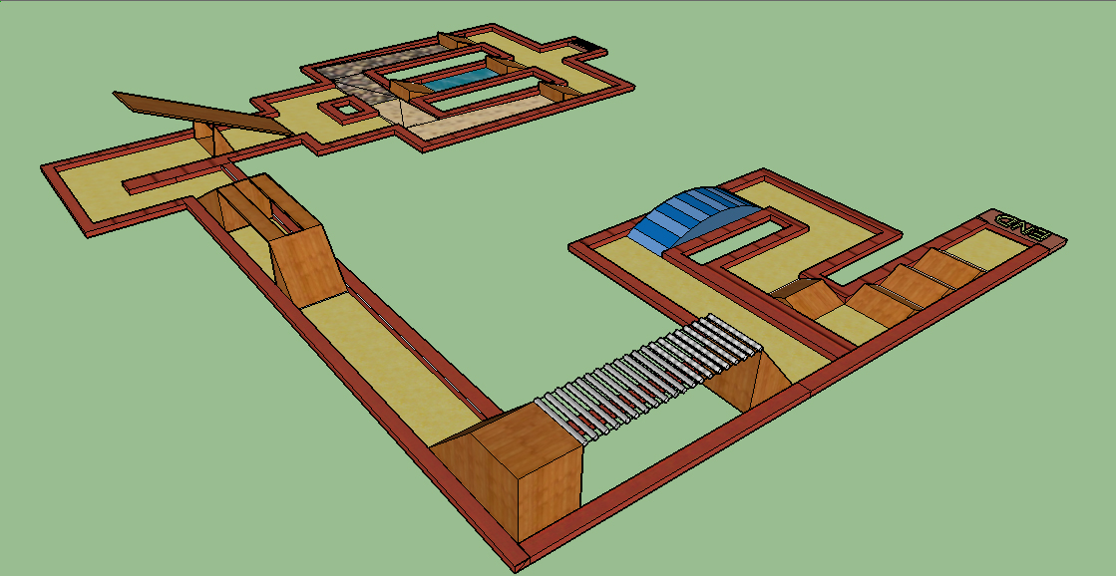

Slide 55
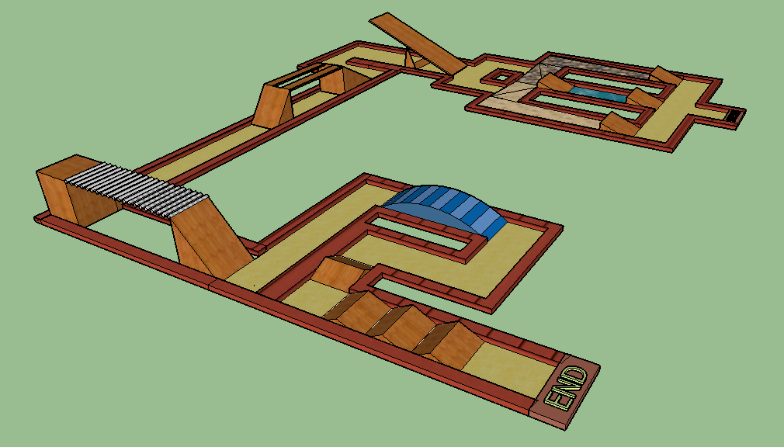

Slide 56
Thank You!!!

